Slide 1
BPL Board of Trustees
Members of the Public are welcome to sign up for Public Comment via the Chat Tab
(You are allowed 2 minutes and will be called in the order received).
Please include:
* name and “Public Comment”
* Phone and/or Email for follow up if needed
(personal info is not visible to public)
Priscilla H. Douglas,Chair
9.24.21

Slide 2
BPL Opening Statement
The Trustees of The Boston Public Library reaffirm our commitment to racial equity and to principles of diversity equity and inclusion, more broadly.
The Library is formally committed to becoming an anti-racist organization in response to systemic racism, inequity, and injustice prevalent in our society.
We acknowledge also that the Boston Public Library’s Central Library stands on land that was once a water-based ecosystem providing sustenance for the indigenous Massachusetts people and is a place which has long served as a site of meeting and exchange among nations. We are committed to land acknowledgements for all locations at which we operate.
We reaffirm this commitment to set the context for our planning, deliberations, and public engagement so that they take place from the spirit of welcome and respect, found in our motto ‘free to all.’
Taken from the Institutional Statement Ratified by the Board of Trustees for the Boston Public Library on September 29, 2020.

Slide 3

Chair’s Report
Priscilla H. Douglas, Chair
Welcome
Roll Call of Trustees
Approval of Minutes from 5.18.21
Updates

Slide 4
New Trustees Committees
Special Collections Committee
Jabari Asim*
Joe Berman*
Ben Bradlee Jr.*
Matthew Dames,
Juan Enriquez
Grace Fey
Jeff Hawkins*
Elizabeth Johnson
David Leonard
Alan Leventhal
Strategic Community Engagement Committee
Joyce Linehan, Chair*
Evelyn Arana-Ortiz*
Zamawa Arenas*
Joseph Berman*
Michelle Coleman
Imari K. Paris Jeffries
David Leonard, President
John Linehan
Dayron J. Miles
Nam Pham
Representative Chynah Tyler*
Pam Waterman

Slide 5


Strategic Community Engagement Collaboration
Arboretum Adult List
Arboretum Youth List

Slide 6
President’s Report
David Leonard, President
Program Partnership Updates Michael Colford, Director of Library Services
BPL Fund Updates
Capital Projects
Major Projects

Slide 7
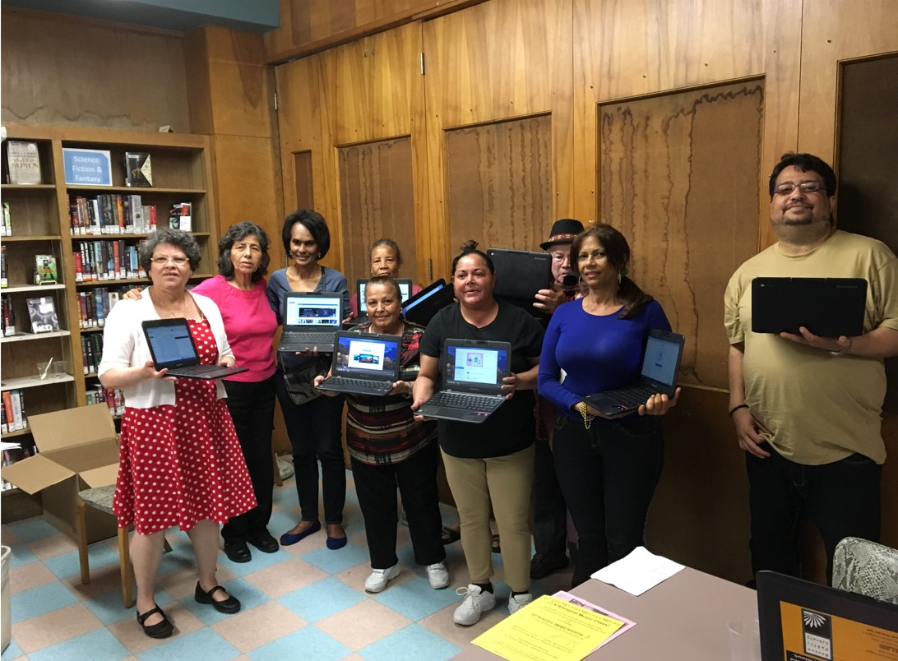
Tech Goes Home

Slide 8
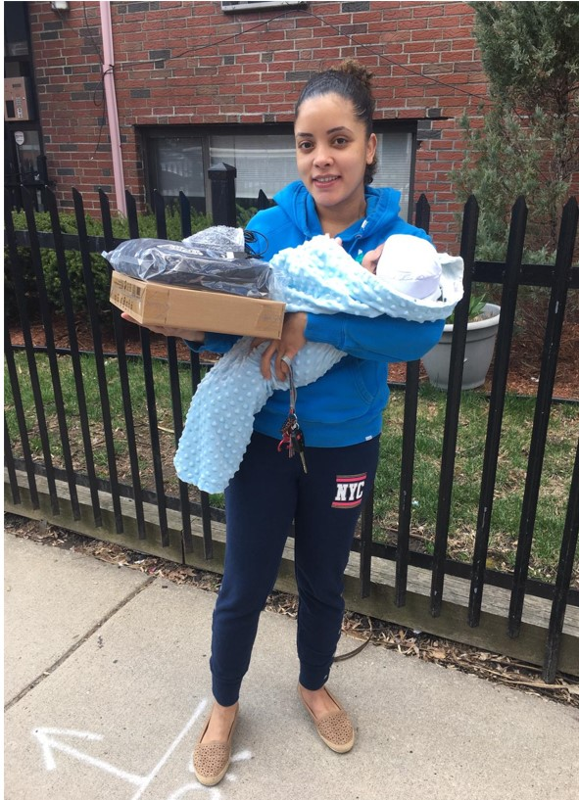
Tech Goes Home

Slide 9
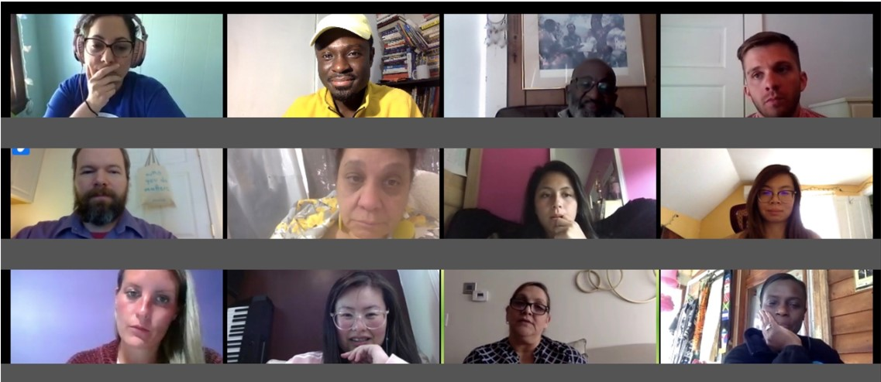
Tech Goes Home

Slide 10
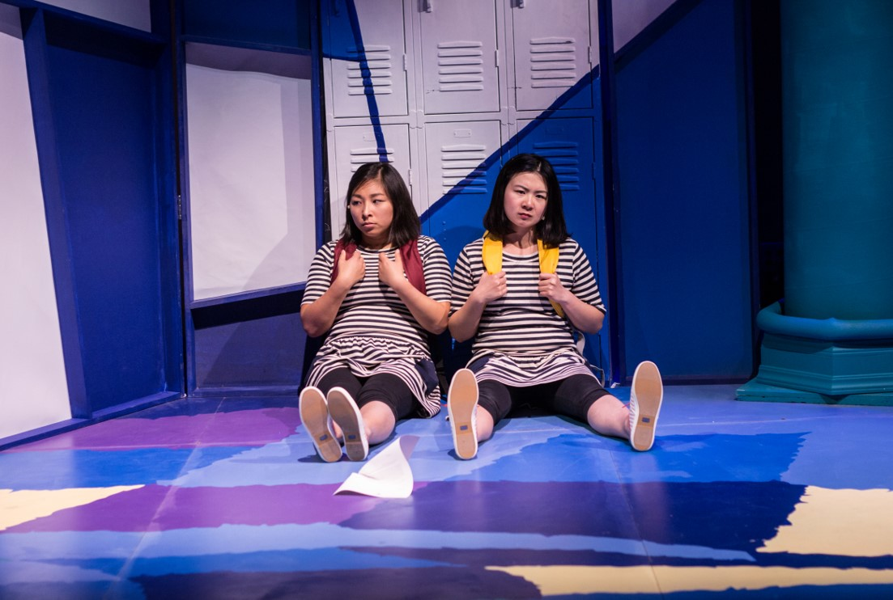
Company One

Slide 11
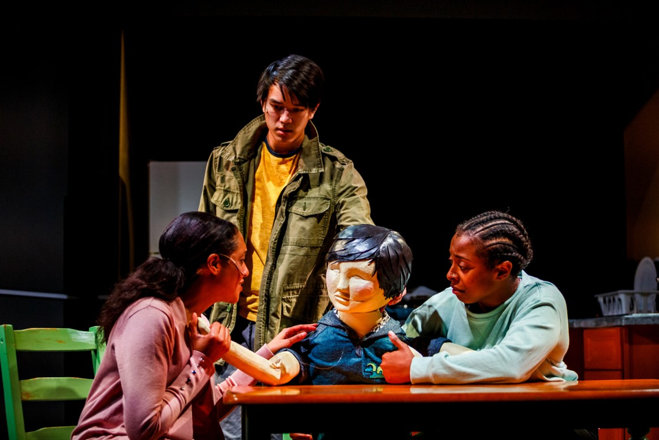
Company One

Slide 12
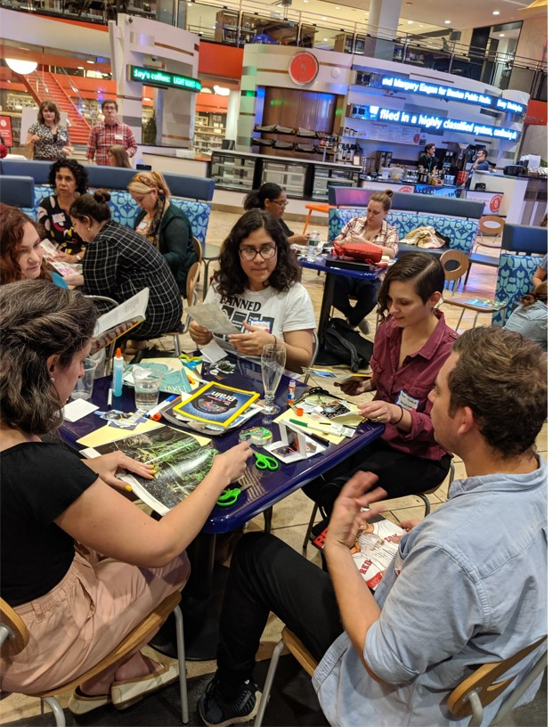
Company One

Slide 13
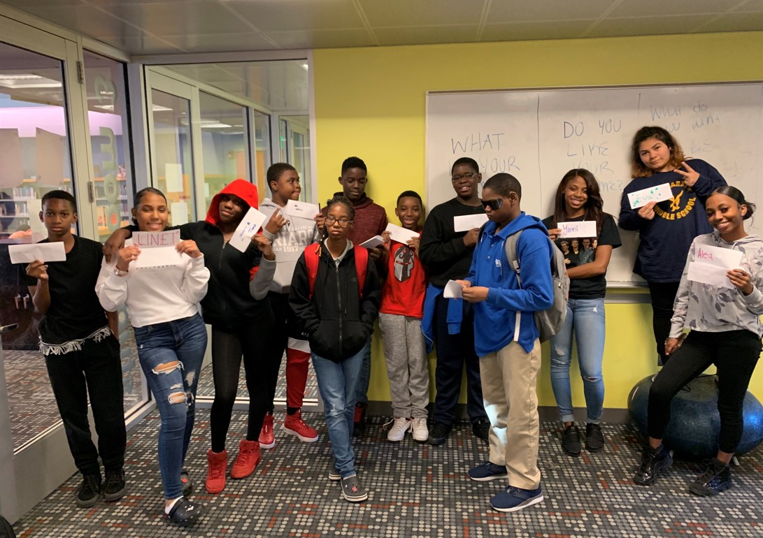
YAWB

Slide 14
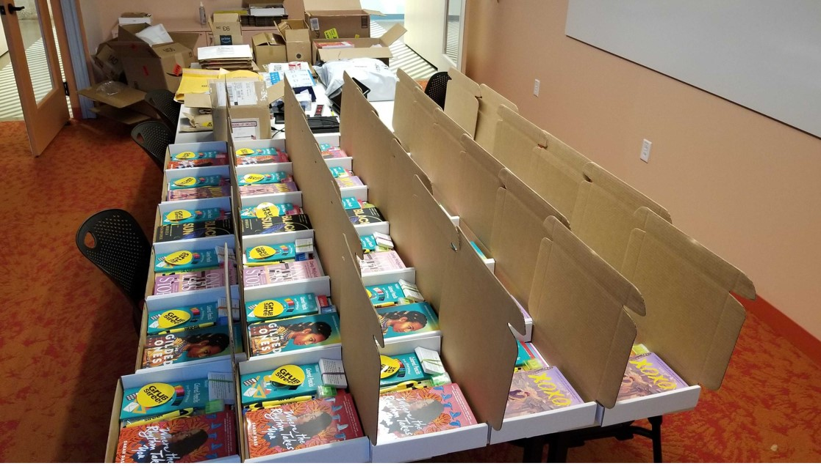
Grub Street

Slide 15
BPL Fund Updates
1. Named Giving Policy
VOTED: “that, the Trustees of the Public Library of the City of Boston vote to acknowledge receipt
of the Boston Public Library Fund’s Named Giving Policy and consent to support and collaborate
on implementation.”
2. Gift Acceptance Policy
VOTED: “that, the Trustees of the Public Library of the City of Boston vote to acknowledge receipt
of the Boston Public Library Fund’s Gift Acceptance Policy and consent to support and collaborate on
implementation.”
3. BPL/BPLF Memorandum of Understanding
VOTED: “that, the Trustees of the Public Library of the City of Boston approve the Memorandum of
Understanding (“MOU”) between the Boston Public Library and the Boston Public Library Fund pending
final review and approval as to form by the Corporation Counsel of the City of Boston.”

Slide 16
President's Report Continued
1. Summer Utilization Numbers
2. Cybersecurity Incident
3. Current Operating Reality / Covid-19
4. Vacancy Challenges: c. 86 Active Openings
5. Milestones Completed:
a. Courtyard Fountain
b. Hyde Park Branch Reopened
c. Adams Street Branch Ribbon Cutting
6. Upcoming Milestones
  a. Roxbury Branch at Nubian Square: Opening Anniversary Celebration – 10/23
  b. Roslindale Branch Ribbon Cutting – Q4, Date TBD
7. Future Trustee Briefings:
  a. YW Boston Work, REAL Training, BPL Equity Agenda & Actions Plan
  b. McKim Master Planning & Potential Capital Campaign

Slide 17
Capital projects/investments
Capital projects completing FY22 Roslindale Branch Rare Books Renovation McKim Master Plan Programming Study West End Programming Study Egleston Branch Programming Study | Capital projects continuing FY22 Faneuil Branch Renovation McKim Fire Panel Replacement Codman Square Branch Programming Study Research Collections Preservation and Storage Plan Chinatown Branch (new location) Uphams Corner Branch (new location) | Capital projects kicking off FY22 Fields Corner Design South End Branch Programming Study North End Branch Programming Study South Boston Branch Programming Study Central Library Facade Study and Repairs

Slide 18
Questions?

Slide 19
Finance & Audit Committee
Evelyn Arana-Ortiz, Committee Chair Ellen Donaghey, Chief Financial Officer

Slide 20
©2021 CliftonLarsonAllen LLP
Trustees of Boston Public Library
FY 21 Audit Summary
WEALTH ADVISORY | OUTSOURCING | AUDIT, TAX, AND CONSULTING

Slide 21
Agenda
©2021 CliftonLarsonAllen LLP
Audit Engagement summary
Financial Statement summary
  Auditors’ Opinion
  Financial highlights
  Significant footnotes and other matters
Items to complete audit
Open forum

Slide 22
Audit Engagement Summary
©2021 CliftonLarsonAllen LLP
Primary audit work began in late July
Information was provided timely and was well organized
Management and staff was responsive to all inquiries
No disagreements with management
The end result was a smooth audit process

Slide 23
Auditors’ Opinion
©2021 CliftonLarsonAllen LLP
Auditors’ Opinion (pages 1-2)
  Unmodified Opinion
    Consistent with prior years and best opinion available
    Opinion as it relates to the Fund for BPL component unit is based on the report of the Fund for BPL’s auditors

Slide 24
Financial Highlights
©2021 CliftonLarsonAllen LLP
General Fund – Fund Balances (page 20)
  Overall fund balance increased approximately $318k (6.4%)
  Restricted - $1.3m
  Committed - $37k (Neighborhood Outreach)
  Assigned - $2.2m
    IT equipment - $1.0m
    Salaries - $466k
    Furniture - $242k
    Operating fund - $394k
    Other - $127k

Slide 25
Financial Highlights
©2021 CliftonLarsonAllen LLP
General Fund – Fund Balances (continued)
  Unassigned – $1,690,388
    Increase from prior year - $348k (26%)
    Unassigned fund balance represents 25% of FY 21 expenditures and transfers out (20% last year)
    Unassigned fund balance previous 4 years:
      FY 17 - $1.2m
      FY 18 - $1.4m
      FY 19 - $1.4m
      FY 20 - $1.7m

Slide 26
Financial Highlights
©2021 CliftonLarsonAllen LLP
Financial Summary
  Nonmajor Governmental Funds – Fund Balances (page 20)
    Nonspendable (trust funds) - $77.9m
    Restricted - $11.0m
      Expendable trust funds - $9.0m
      General trust (various restricted grants/gifts) - $1.6m
    Assigned (Deferrari Fund) - $1.2m
  Fund Balance the past 5 years:
    FY 17 - $68.1m
    FY 18 - $70.6m
    FY 19 - $72.2m
    FY 20 - $72.1m
    FY 21 - $90.2m

Slide 27
Financial Highlights
©2021 CliftonLarsonAllen LLP
Revenues (page 21)
  Intergovernmental - $4.8m
  Special events - $43k
  Fees and fines for services - $154k
  Contributions and gifts - $3.9m
  E-Rate - $692k
  In-Kind Contributions - $223k
  Investment income - $20.0m

Slide 28
Financial Highlights
©2021 CliftonLarsonAllen LLP
Revenues (continued)
  Total Revenues over the past 5 years
    FY 17 - $19.6m
    FY 18 - $11.2m
    FY 19 - $12.6m
    FY 20 - $10.4m
    FY 21 – $29.8m
  Trends/Fluctuations:
    Decrease from FY 17 to FY 18 primarily relates to the BPL Foundation transferring donations to the BPL in FY 17 in anticipation of their pending dissolution
    Increase from FY 20 to FY 21 primarily relates to investment gains/income in FY 21

Slide 29
Financial Highlights
©2021 CliftonLarsonAllen LLP
Expenses (page 21)
  Salaries and benefits - $3.4m
  Books and related materials - $1.7m
  Programs - $707k
  Administrative - $965k
  Contractual services and utilities - $1.8m
  Equipment, furniture and R&M - $932k
  E-Rate - $692k
  Related to In-Kind Contributions - $223k

Slide 30
Financial Highlights
©2021 CliftonLarsonAllen LLP
Expenses (continued)
  Expenses the past 5 years:
    FY 17 - $12.4m
    FY 18 - $8.7m
    FY 19 - $10.0m
    FY 20 - $10.3m
    FY 21 - $10.3m
  Trends/Fluctuations:
    Decrease from FY 17 to FY 18 primarily relates to FY 17 non- recurring expense for the transfer of proceeds from sale of Norwood storage facility to the City of Boston
    Salary expenses – has ranged between $2.3m and $3.4m
    Contractual Svc’s/Utilities and Equip/Furniture/Maintenance have shown fluctuations up and down based on current year needs

Slide 31
Items to Complete Audit
©2021 CliftonLarsonAllen LLP
Completion of “Fund for BPL” component unit audit
Representation letter from “Fund for BPL” auditors

Slide 32
Open Forum
©2021 CliftonLarsonAllen LLP
We welcome any questions about the audit

Slide 33
Finance & Audit Committee (continued)
Review of BPL Draft Audited Financial Statements for Fiscal Year Ending June 30, 2021
VOTED: “that, the Trustees of the Public Library of the City of Boston approve the Boston Public Library’s Draft Audited Financial Statements for the Fiscal Year ending June 30, 2021.”

Slide 34
Gifts, Grants, Donations to the Boston Public Library FY2021 Purpose
Donor
Amount
Fund for the Boston Public Library | Founding Research Collection Project/Collection Acquisition | 899,038
 | Youth Programs Homework Help | 309,360
 | Community Learning | 137,825
 | Lowell Lecture | 101,211
 | Roxbury Nutrition Lab | 88,350
 | Other | 610,744
Total Fund for the Boston Public Library |  | 2,146,528
Associates of the Boston Public Library | Salary Support | 755,532
 | Founding Research Collection Project | 110,000
 | Other | 77,000
Total Associates of the Boston Public Library |  | 942,532
Marilee Wheeler 2005 Trust | Unrestricted | 400,000
Dr. Miliades Karamechedis Trust Fund | Preservation Fund | 235,710
Estate of Thomas O'Brien | Unrestricted | 107,551
Marathon Team |  | 10,610
Charity Alker | Dorothy Alker Trust for the Uphams Corner Branch | 5,000
Marcos & Nika Elugardo | Friends of the Parker Hill Branch | 1,500
Carlos Vasquez | Children's Books | 1,500
Friends of Jamaica Plain | Museum Passes | 1,310
Friends of West Roxbury | Museum Passes | 1,140
Friends of East Boston | Museum Passes | 400
Friends of Grove Hall | Museum Passes
Friends of Hyde Park | Museum Passes | 400
Friends of Parker Hill |  | 220
Friends of Connolly | Museum Passes | 195
Colin Joy Project | South Boston Branch | 600
Other |  | 4,064
 |  | 3,859,260
9/13/2021
2021 Gift Report.xls

Slide 35
Vote for Executive Session
  The purpose for the Executive Session is to discuss Cyber Security under exemption #4 of the MA Open Meeting Law.
    Clerk will take roll call of the Board to vote on entering into an Executive Session.
    Meeting will take place immediately following the Public Meeting
    The Board will not reconvene in a public session.
VOTED: “that, the Trustees of the Public Library of the City of Boston vote to enter into Executive Session.”

Slide 36
New Business
Priscilla H. Douglas, Chair

Slide 37
Public Comment
You may sign-up via the “Chat” Tab
Participants are asked to leave
“NAME” and “PUBLIC COMMENT”
If follow up is required, please leave your contact email or phone number for follow up
(this is not viewable to the Public)
People will be chosen in the order they were received and allowed 2 minutes to speak.
The Moderator will unmute your mic when you are called on.
Comments made in chat during meeting will not be acknowledged.

Slide 38
BPL Board of TrusteeS
Next meeting held November 16, 2021, 8:30 a.m.
* Subject to change*

