Slide 1

Market and Portfolio Update
BOSTON PUBLIC LIBRARY
March 5, 2024
Sebastian Grzejka, CAIA, Partner

Slide 2

Nepc’s annual investment conference
Save the date
Please save the date for our Investment Conference on Monday, September 9 and Tuesday, September 10
We are thrilled to welcome you back to Boston this year at the Westin Copley Place Hotel
In addition to our dynamic speakers and breakout sessions, there will also be plenty of opportunities to network with your peers
Registration and additional details will follow in the coming months. Please reach out to Sarah Winrow: swinrow@nepc.com with any questions

Slide 3
Executive summary

Slide 4
Boston Public Library Executive Summary
Overview of recent implementation decisions and priorities:
Recommendations
  Portfolio rebalancing to be discussed at upcoming BPL Board meeting
  Asset allocation review to be discussed at the upcoming BPL Board meeting
YTD Performance Update:
Contributors:
  Overall large cap exposure, driven by the S&P 500 helped returns for the year
  Fixed income managers provided sound absolute returns and yield for the year
Detractors:
  Impax Global Equity struggled on a relative basis, trailing their benchmark by over 100 bps
Policy
Current
* Periods greater than one year are annualized
* New Policy targets approved in 3/2021
Notes:
Update with IPA

Slide 5
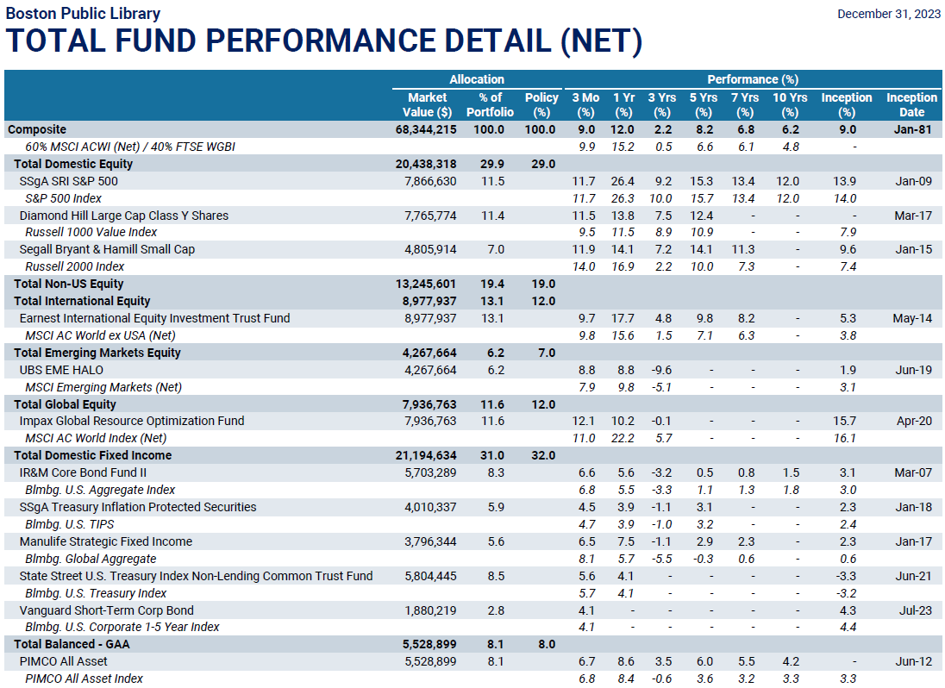
-PIMCO All Asset Index consists of 40% Bloomberg Aggregate / 30% Bloomberg US TIPS Index/ 10% S&P 500 / 10% HY / 10% JPM EMBI + TR
-New Policy % targets as of 4/1/2020; Returns are net of fees.
-Fiscal year starts 7/1

Slide 6
Capital markets overview and outlook

Slide 7
Q4 2023 in review
U.S. stocks broadly outperformed during Q4
  The fourth quarter witnessed robust performance in U.S. equities, driven by lower inflation figures and strong economic data
  The S&P 500 index surged by nearly 12% during the quarter and concluded the year with an impressive gain of over 26%.
International equity markets experienced similar gains due to lower interest rate fears and strong small cap performance
  International developed and emerging market equities posted positive performance, with the MSCI EAFE Index returning 10% in the fourth quarter and an impressive 18% for the entire year.
  The MSCI EM Index recorded approximately 8% gains in the fourth quarter, contributing to a solid 10% increase for the year 2023, demonstrating resilience in emerging markets.
Fixed income markets suffered amidst continued messaging from the Fed of higher interest rates
  Treasuries experienced a turnaround in the fourth quarter, driven by a more dovish Federal Reserve, resulting in a rally in shorter maturities.
  Credit spreads tightened in fixed-income markets, leading to positive returns, with investment-grade corporate bonds seeing a 22 basis point reduction in spreads and high-yield corporate bonds experiencing a substantial 71 basis point reduction.

Slide 8





Current Market Outlook
Better-than-expected economic data pushed out market rate cut expectations, even as markets remain biased to lower rates
The Magnificent 7 supported broader index returns as stronger-than-expected earnings bolstered performance
We are concerned about U.S. mega-caps and suggest reducing exposure, while maintaining U.S. large-cap value exposure
We remain comfortable holding greater levels of cash to heighten portfolio liquidity levels
U.S. TIPS remain attractive with normalized real interest rate levels and subdued breakeven inflation expectations

Slide 9
Magnificent seven
Dominant performance in 2023

Slide 10
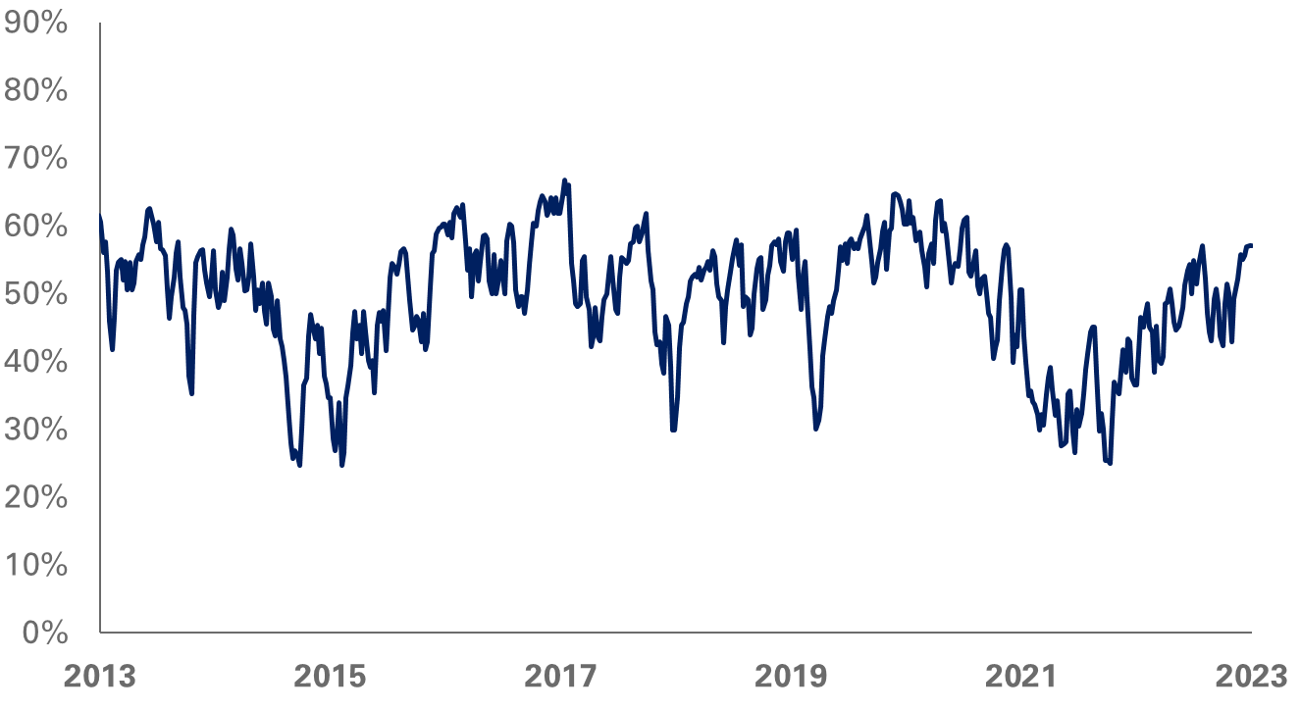
Investor Sentiment Surged in 2023
Investors Intelligence Bullish Sentiment Index
Source: Investors Intelligence, FactSet

Slide 11
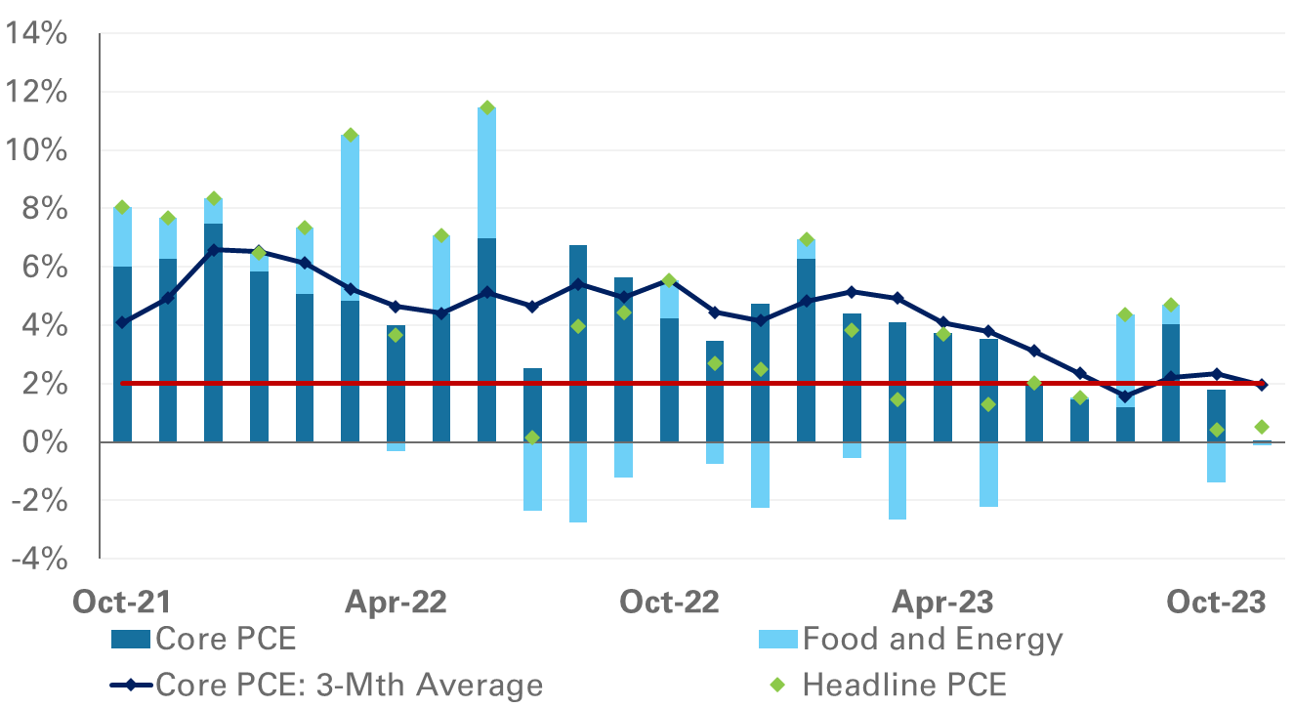
Core Inflation trended To the Fed’s Target
Annualized Monthly U.S. PCE Price Index Changes
Sources: Bureau of Labor Statistics, FactSet

Slide 12
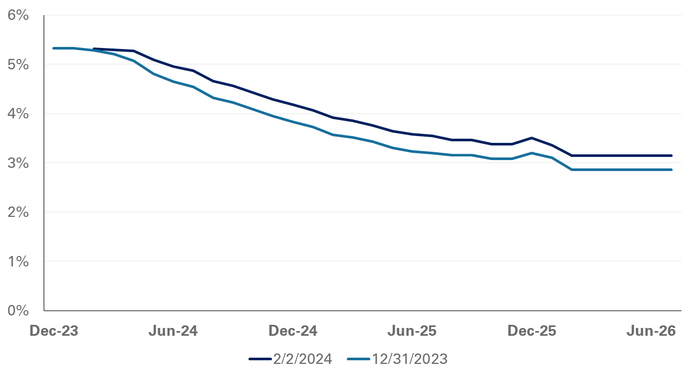
The market now expects five cuts in 2024
Federal Fund Futures
Market-based expectations for rate cuts have been pushed out from March to June after Fed Chair Jerome Powell announced that a rate cut at the March meeting is “unlikely”

Slide 13








Market backdrop
2022
2024
2022
2024
S&P 500
4,766
4,769
Fed Funds
0.25
5.50
IG OAS
0.92
0.99
US 10 Year
1.51
3.88
HY OAS
2.93
3.23
CPI
7.19
3.12
Gold
1,895
2,072
Oil
75
72

Slide 14




2024 Market Themes
NEPC Market Outlook
Cost of Capital
Economy is not acclimated to long-term interest rate environment of 4% or higher
Magnificent Seven
Priced for Perfection: Sky-high earnings growth expectations challenge potential valuation upside
U.S. Fiscal Debt
Fundamentals suggest perpetual deficit cycle requires higher interest rates
Artificial Intelligence
AI Proof Statement: Novel products and successful adoption will test valuations in 2024
Geopolitics
The speed of information amplifies tail risks; look to rebalance opportunities amid volatility

Slide 15
Asset allocation update

Slide 16




Investment Regime Shifts Take time
2024 Market Outlook
Economic Resilience
Robust labor market reinforces a “no recession” outcome for the U.S.
Long and Variable Monetary Policy Lag
Access to capital and liquidity slowly adjusting to the investment landscape
Higher for Longer
Interest Rates
Market participants have not accepted long-term interest rates above 4%
Inflation Expectations
Are Awry
Market expectations are anchored to the low inflation levels of the past decade
Geopolitical Dynamics
Geopolitical trends are straining supply chains and macroeconomic conditions

Slide 17
NEPC Strategic Asset Allocation Views
The current efficient frontier curve has flattened - a flat risk curve reduces the marginal benefit of adding risk to the portfolio
The market environment offers a challenging path for several years and will be difficult to repeat the last decade of strong returns
Be mindful of long-term wealth objectives as shifts to fixed income from equity limit the potential return upside for portfolios
Equity exposure over the long-term offers a wider range of outcomes and can provide returns well-above median expectations

Slide 18
Asset Allocation overview
The current allocation is structured to utilize a balanced, total return approach. We recommend minor adjustments, while maintaining risk and return objectives.
 | Current Policy | Recommended Target | Recommended Policy Ranges
Large Cap | 22% | 22% | 20%-40%
SMID Cap | 7% | 7%
Global Equity | 12% | 15% | 10%-18%
Non US Equity | 12% | 10% | 8%-15%
Emerging Equity | 7% | 6% | 3%-10%
Total Equity | 60% | 60%
US Aggregate Bonds | 10% | 10% | 25%-35%
Multi Sector Credit | 8% | 12% | 0%-25%
TIPS | 7% | 4%
US Treasury Bonds | 7% | 8%
Total Debt | 32% | 34%
Multi Asset | 8% | 6% | 4%-10%
Total Multi Asset | 8% | 6%
The recommended target looks to adjust exposure towards areas of market opportunities, much of which can be achieved through rebalancing.
In equity, increase in global equity looks to focus on flexibility and an area of strong active management. Given the size of the allocation, we recommend adding a complementary manager to Impax.
Measure*
Expected Return (10 Years) | 5.5% | 5.5%
Standard Deviation | 12.3% | 12.3%
Sharpe Ratio (10 Years) | 0.13 | 0.13
In fixed income, focus on balancing defensiveness, liquidity and yield. Diversified credit offers access to higher yielding assets in todays market.

Slide 19
Rebalancing recommendation

Slide 20
Core Asset Class Return Assumptions
 | Asset Class | 12/31/23 10-Year Return | 12/31/22 10-Year Return | Delta
 | Cash | 3.9% | 4.0% | -0.1%
 | U.S. Inflation | 2.6% | 2.5% | +0.1%
Equity | U.S. Large-Cap Equity | 4.4% | 5.4% | -1.0%
 | Non-U.S. Developed Equity | 4.6% | 5.6% | -1.0%
 | Emerging Market Equity | 8.6% | 9.6% | -1.0%
 | Global Equity* | 5.4% | 6.3% | -0.9%
 | Private Equity* | 9.0% | 9.2% | -0.2%
Fixed Income | U.S. Treasury Bond | 4.2% | 4.2% | -
 | U.S. Municipal Bond | 3.5% | 4.4% | -0.9%
 | U.S. Aggregate Bond* | 4.6% | 4.8% | -0.2%
 | U.S. TIPS | 4.6% | 4.4% | +0.2%
 | U.S. High Yield Corporate Bond | 6.1% | 7.1% | -1.0%
 | Private Debt* | 8.3% | 8.8% | -0.5%
Real Assets | Commodity Futures | 4.6% | 4.2% | +0.4%
 | REIT | 6.0% | 6.2% | -0.2%
 | Gold | 4.9% | 5.1% | -0.2%
 | Real Estate - Core | 5.4% | 4.0% | +1.4%
 | Private Real Assets - Infrastructure | 6.8% | 6.6% | +0.2%
Multi-Asset | 60% S&P 500 & 40% U.S. Aggregate | 4.8% | 5.3% | -0.5%
 | 60% MSCI ACWI & 40% U.S. Agg. | 5.4% | 6.0% | -0.6%
 | Hedge Fund* | 6.1% | 6.5% | -0.4%
*Calculated as a blend of other asset classes

Slide 21
Appendix
This is a preview version. Do not publish.

Slide 22
U.S. Inflation assumptions
Overview
Inflation is a key building block to develop asset class assumptions
Inflation assumptions are model-driven and informed by multiple inputs for both the U.S. and global assets
NEPC’s inflation assumption forecasts near-term paths for major Consumer Price Index (CPI) components including food, energy, core services, and shelter costs
  CPI is expected to converge with breakeven inflation rates over the long-term
A composite inflation assumption reflects a blend of NEPC’s inflation forecast and market-implied breakeven inflation rates
Region | 10-Year Inflation Assumption | 12-Month Change | 30-Year Inflation Assumption | 12-Month Change
United States | 2.6% | +0.1% | 2.6% | -

Slide 23
Information Disclaimer
Past performance is no guarantee of future results.
The goal of this report is to provide a basis for substantiating asset allocation recommendations. The opinions presented herein represent the good faith views of NEPC as of the date of this report and are subject to change at any time.
Information on market indices was provided by sources external to NEPC. While NEPC has exercised reasonable professional care in preparing this report, we cannot guarantee the accuracy of all source information contained within.
All investments carry some level of risk. Diversification and other asset allocation techniques do not ensure profit or protect against losses.
This report is provided as a management aid for the client’s internal use only. This report may contain confidential or proprietary information and may not be copied or redistributed to any party not legally entitled to receive it.

